Slide 1
Apple Stock price Prediction
GROUP 6
Under the guidance of Geethika mam
Submitted by
Siddhika S.Tharun Kumar G. Harshith Kumar
Vishram Dalvi
T Nagavardhana Reddy

Slide 2
Objective
This project focuses on forecasting Apple stock prices using advanced Time Series Forecasting and Machine Learning techniques.
Historical stock market data was analyze to identify trends, seasonality, and market behaviour patterns.
Multiple forecasting models, including ARIMA, SARIMA, and XGBoost, were developed and evaluated using RMSE and MAE metrics.
The objective was to identify the most accurate model for predicting future stock prices and generate actionable insights for investment decision-making.
Among all models, SARIMA achieved the highest forecasting accuracy and was selected as the final prediction model.

Slide 3
Dataset Details
Dataset Name: Apple Historical Stock Price Dataset
Objective: Analyze historical stock market data and forecast future Apple stock prices using Time Series and Machine Learning models.
Dataset Characteristics
Total Records: 12,066
Data Type: Historical Time Series Data
Forecast Horizon: 30 Days
Features Used
Business Value
Understand stock price trends and volatility.
Identify historical market patterns.
Build predictive models for future stock price forecasting.
FeatureDescription
Date | Trading Date
Open | Opening Stock Price
High | Highest Price of the Day
Low | Lowest Price of the Day
Close | Closing Stock Price
Volume | Number of Shares Traded

Slide 4
Data Pre-Processing
📥 Raw Data
⬇ Collected raw data from Apple Stock price
⬇ Data in tabular format
🧹 Data Cleaning
⬇ Removed or imputed missing data
⬇ Ensure data completeness
📅 Date Conversion
⬇ Converted Date into datetime format.
🔄 Data Transformation
⬇Prepared clean and structured time-series data.
⬇Created model-ready datasets.
📊 Model-Ready Dataset
Improved forecasting accuracy and reliability.

Slide 5
EDA- Exploratory data Analysis
Exploratory Data Analysis (EDA)
Overview
Exploratory Data Analysis was performed to understand stock price behaviour, identify trends, detect patterns, and uncover relationships within the dataset before model development.
Key Findings
Analyzed historical stock price movements over time.
Identified long-term growth trends in Apple stock.
Observed market volatility and price fluctuations.
Examined trading volume patterns.
Detected seasonal market behaviour.
Outcome
Provided insights into market trends.
Helped identify important features for forecasting.
Supported model selection and feature engineering.

Slide 6
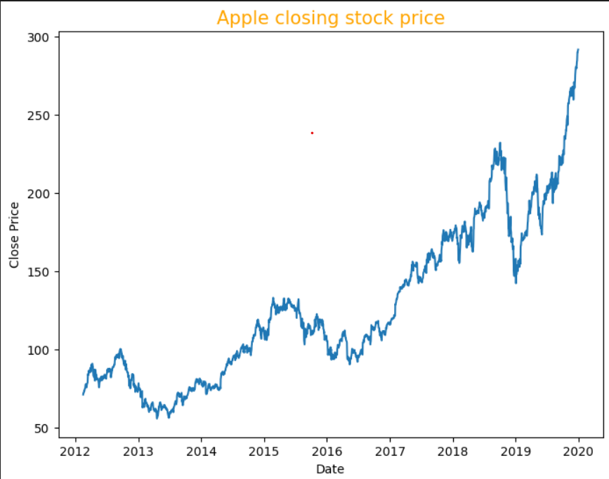
Apple closing stock Price
Overview This visualization illustrates the historical closing stock prices of Apple over time. The analysis was conducted to understand long-term price movements, identify market trends, and evaluate the stock's suitability for forecasting using Time Series and Machine Learning models.
Key Observations
Strong upward trend from 2012 to 2020.
Short-term fluctuations and market corrections observed.
Significant price growth after 2017.
Business Insight
Apple demonstrates strong long-term growth potential.
Historical trends support accurate stock price forecasting.
Useful for investment planning and data-driven decision-making. 📈

Slide 7
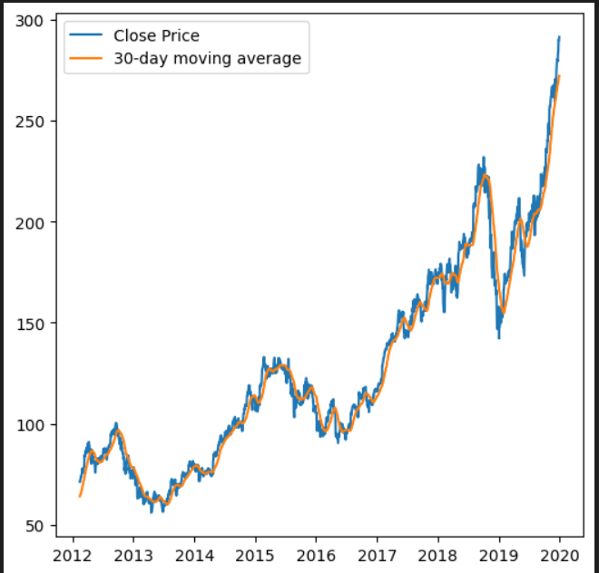
Comparison Between stock price and moving Average
Overview
Compared Apple's closing stock price with its 30-day moving average.
Used to identify long-term trends and smooth short-term price fluctuations.
Helps understand overall market direction and stock momentum.
Key Observations
The 30-day moving average closely follows the stock price trend.
Both lines show a strong upward trend over time.
Short-term fluctuations are smoothed by the moving average.
Significant growth is observed after 2017, reaching peak levels by 2020.
Business Insight
The moving average confirms Apple's long-term bullish trend.
Useful for identifying trend direction and reducing market noise.
Supports investment decisions and improves forecasting accuracy. 📈

Slide 8
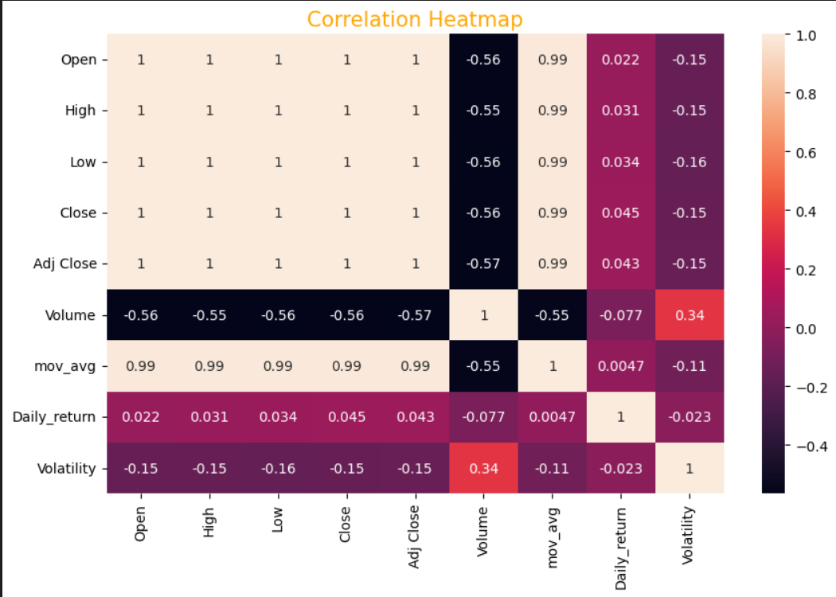
Correlation Heatmap
Overview
A correlation heatmap was used to measure the strength and direction of relationships between stock market features.
Helps identify the most influential variables affecting stock price movements.
Key Observations
Open, High, Low, Close, and Adjusted Close show a very strong positive correlation (≈ 1.0).
30-Day Moving Average is highly correlated with stock prices (0.99).
Volume has a moderate negative correlation with stock prices (≈ -0.56).
Business Insight
Price-related features are the strongest predictors of future stock prices.
Moving Average is an important feature for forecasting models.
Volume and Volatility provide additional market behaviour insights but have less impact on price prediction.

Slide 9
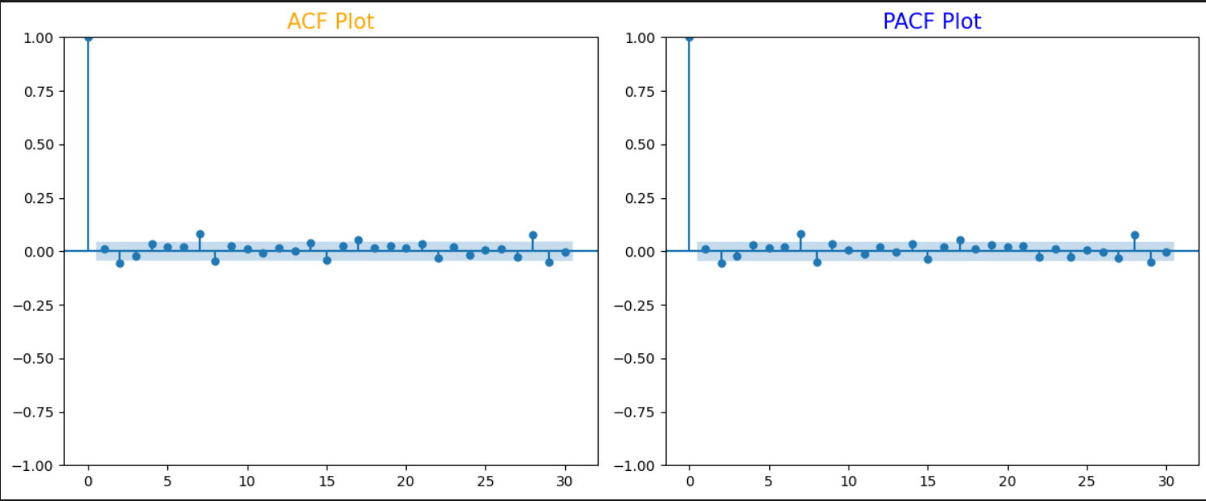
Time Series Analysis
Checked Stationery using ADF Test
Applied differencing to remove trends
Use ACF and PACF for parameter selection

Slide 10
MODEL BUILDING OVERVIEW
Overview
Developed multiple forecasting models to predict Apple stock prices.
Compared model performance to identify the most accurate forecasting approach.
Approach
Prepared training and testing datasets.
Applied Time Series and Machine Learning techniques.
Evaluated models using RMSE and MAE metrics.
Models Applied
ARIMA – Baseline time series forecasting model.
SARIMA – Seasonal forecasting model.
XGBoost – Machine learning-based prediction model.
Objective
Forecast future Apple stock prices accurately.
Compare model performance and prediction accuracy.
Select the best-performing model for future forecasting and investment insights.

Slide 11
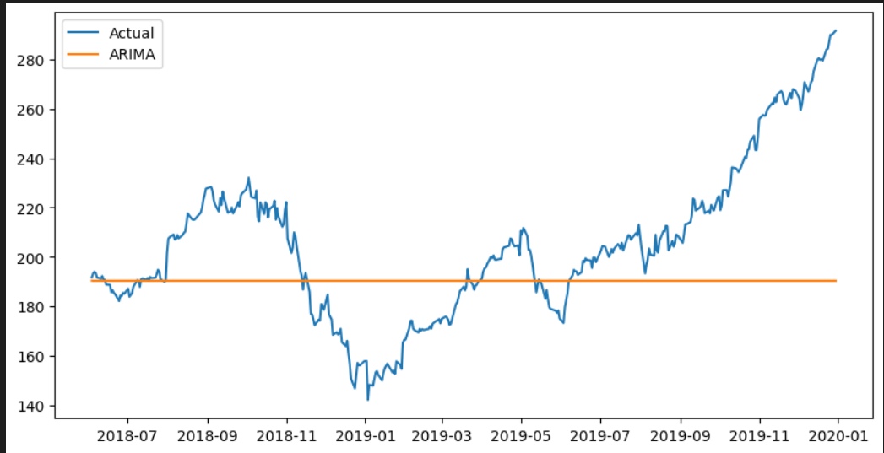
ARIMA MODEL
Arima is the most common forecasting model.
Traditional statistical forecasting model
Capture historical trends and patterns
Used as a baseline forecasting approach

Slide 12
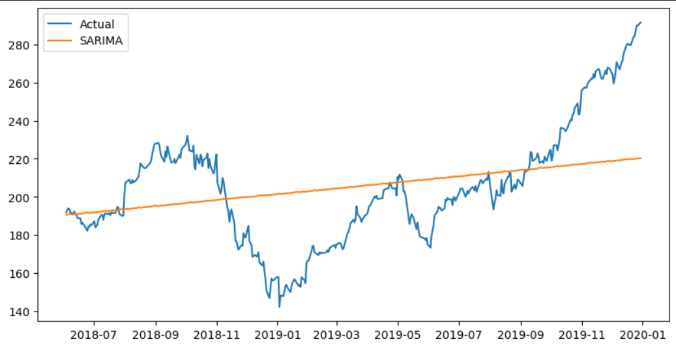
SARIMA MODEL
Enhanced Arima with seasonal components
Capture recurring market behaviour
Improve forecasting for seasonal trends

Slide 13
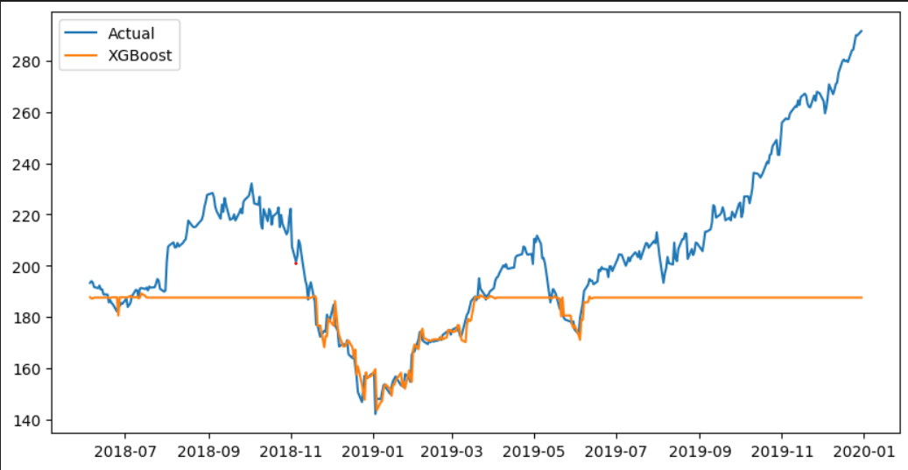
XGBOOST MODEL
Machine learning based forecasting model
Handle complex feature relationships
Achieved highest prediction accuracy

Slide 14
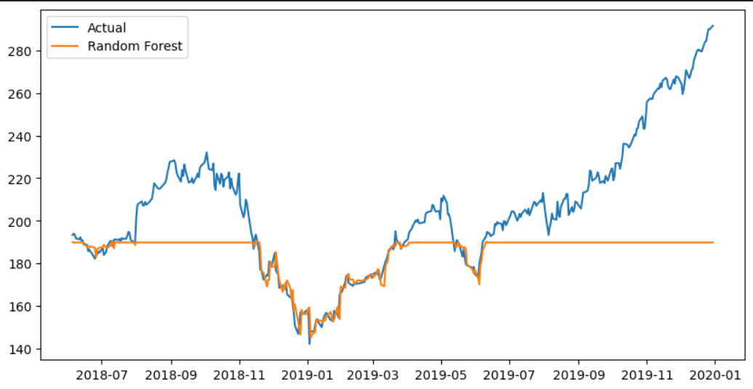
RANDOM FOREST REGRESSOR
Random Forest captured the overall stock price trend but was less effective in modelling sharp market fluctuations, indicating the need for more advanced forecasting techniques. 📈

Slide 15
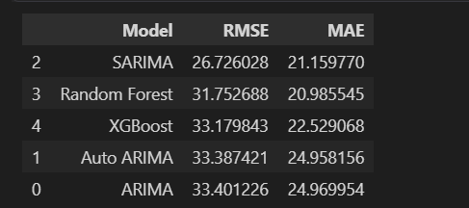
MODEL COMPARSION
Overview
Compared the performance of five forecasting models using RMSE and MAE metrics.
Lower RMSE and MAE values indicate better prediction accuracy.
Evaluated models using RMSE and MAE.
SARIMA achieved the lowest RMSE (26.73).
Random Forest achieved the lowest MAE (20.99).
SARIMA selected as the final forecasting model.
Seasonal modelling improved prediction accuracy.
Best Model SARIMA outperformed all models by achieving the lowest forecasting error, making it the most reliable model for Apple stock price prediction.

Slide 16
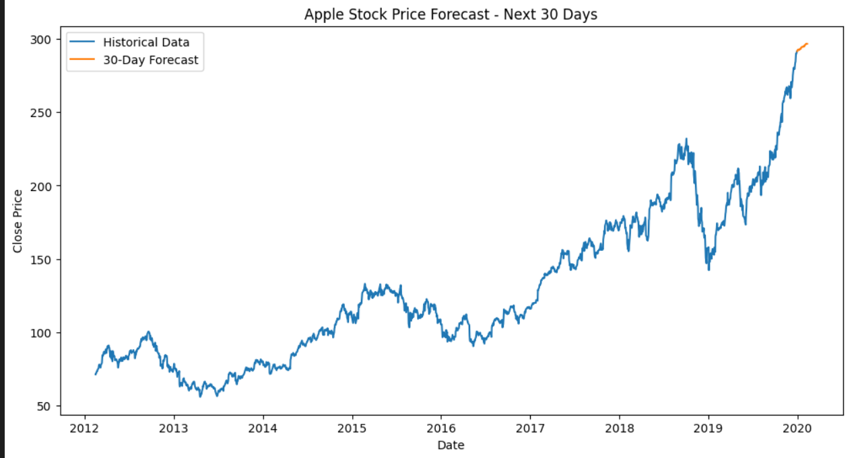
Forecasting Results
Generated 30-day stock price forecast
Identified future trend direction

Slide 17
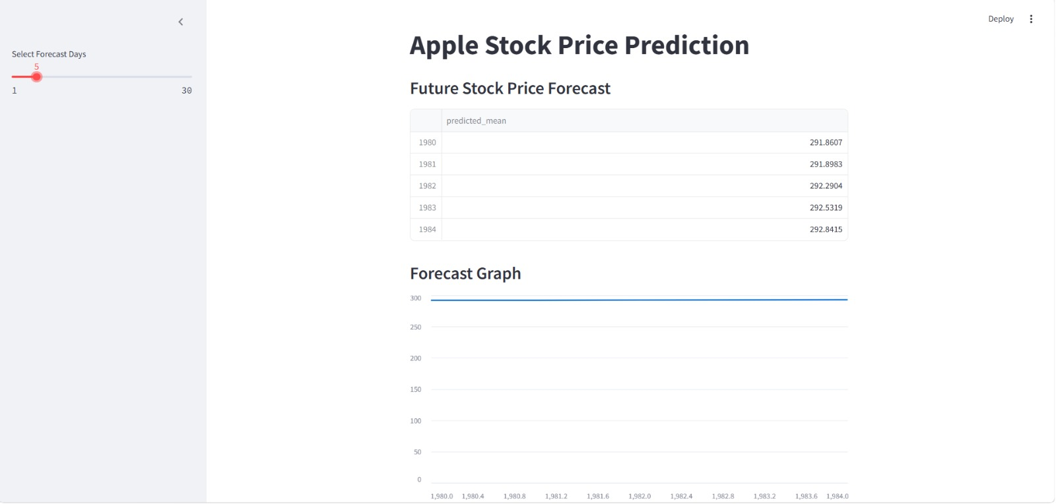
Model Deployment

Slide 18
CHALLENGES FACED
3.Overfitting risk
Time series data was non-stationery and required differencing.
Solutions 1.Used ACF/PACF plots for parameter selection
2.Created lag features and moving
averages
3. Evaluated model using RMSE and MAE
2. Model parameter tuning(ARIMA/SARIMA).
4.Model performance comparison

Slide 19
Conclusion
1
Successfully Forecasted Apple stock prices
2
Compared multiple forecasting techniques
3
Delivered data driven market insights.
4
SARIMA achieved the best forecasting performance with the lowest RMSE (26.73), making it the most reliable model for stock price prediction.
Mercury is the closest planet to the Sun
5
The project demonstrates how Time Series Analysis and Machine Learning can support data-driven investment decisions and future market forecasting. 🚀📈

Slide 20
THANK YOU

